Slide 1
Unix Project Thing
Print screens of what happened

Slide 2
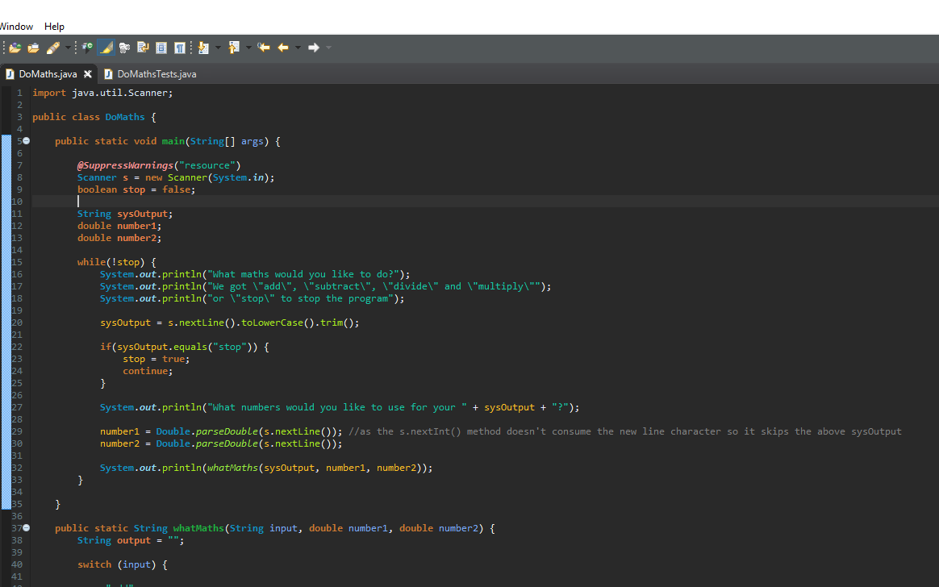
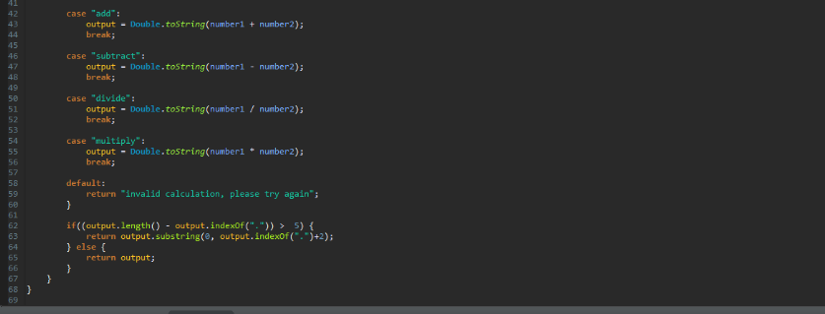
Working code for the calculator

Slide 3
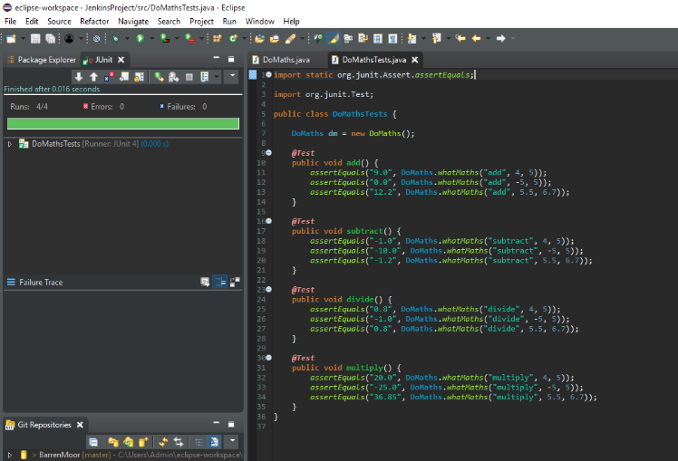
Working code for test suit for calculator

Slide 4
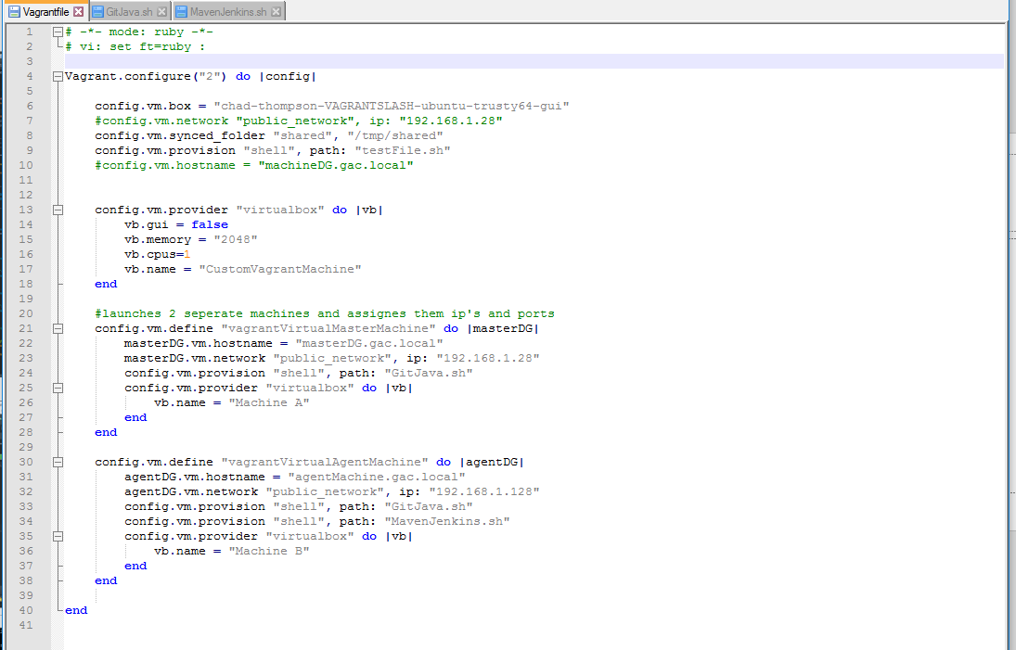
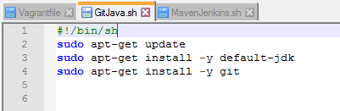
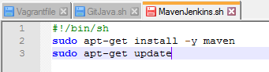
Vagrant setup files and installs for VM’s

Slide 5
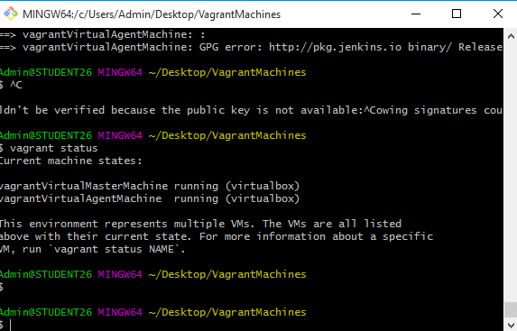
Creating the vagrant machines in bash

Slide 6

SSH’d into the vagrant machines

Slide 7
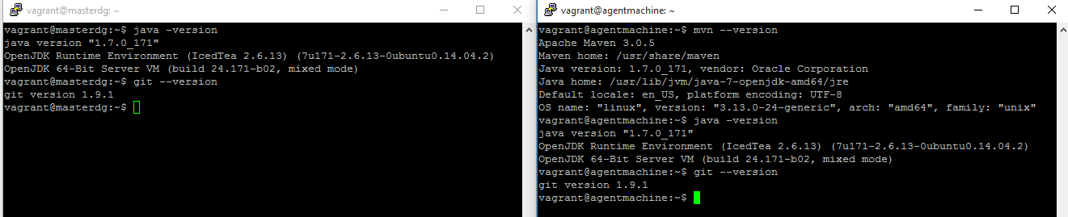
Checking that Java, Git and Maven are installed

Slide 8
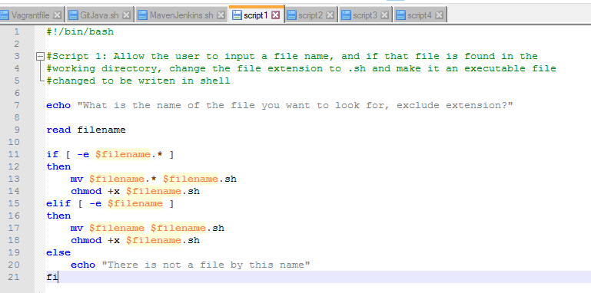
Script 1

Slide 9
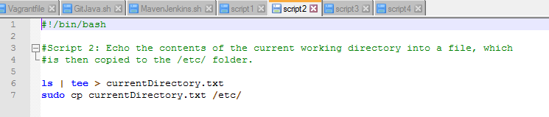
Script 2

Slide 10
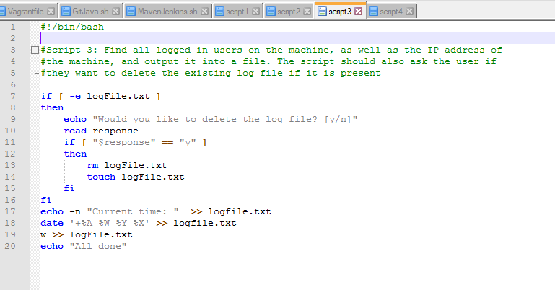
Script 3

Slide 11
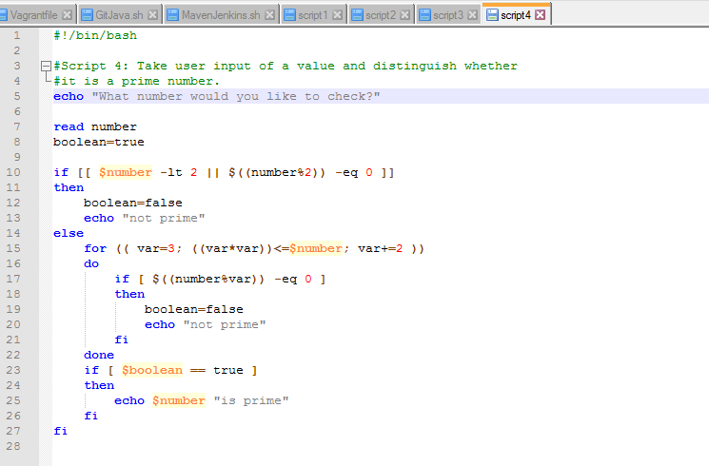
Script 4

Slide 12
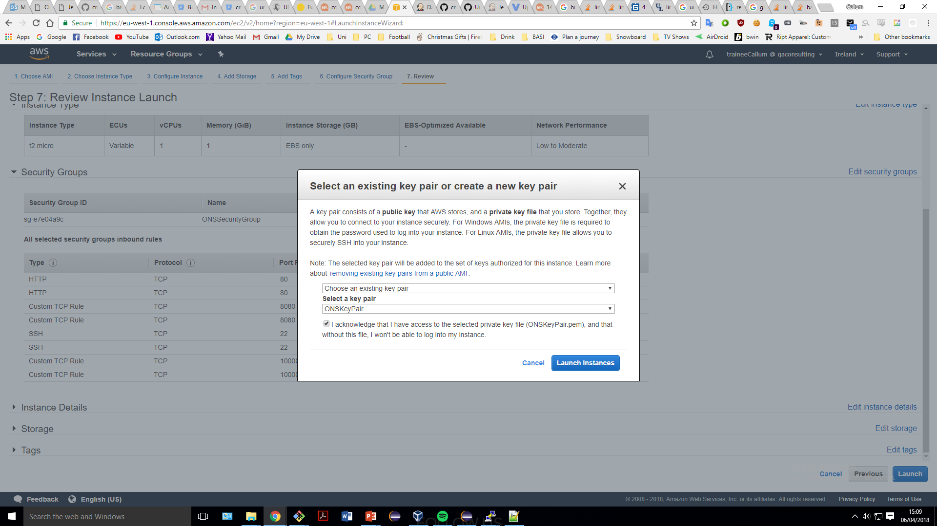
Creating the AWS machine

Slide 13
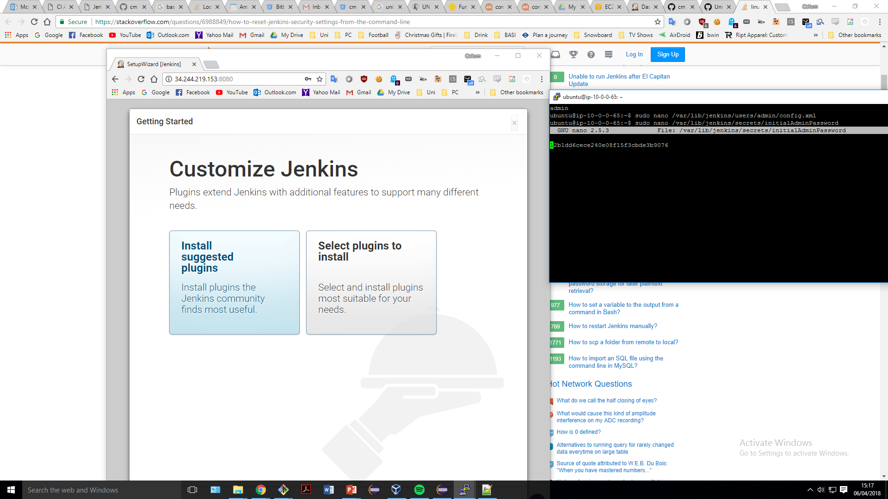
I

Slide 14
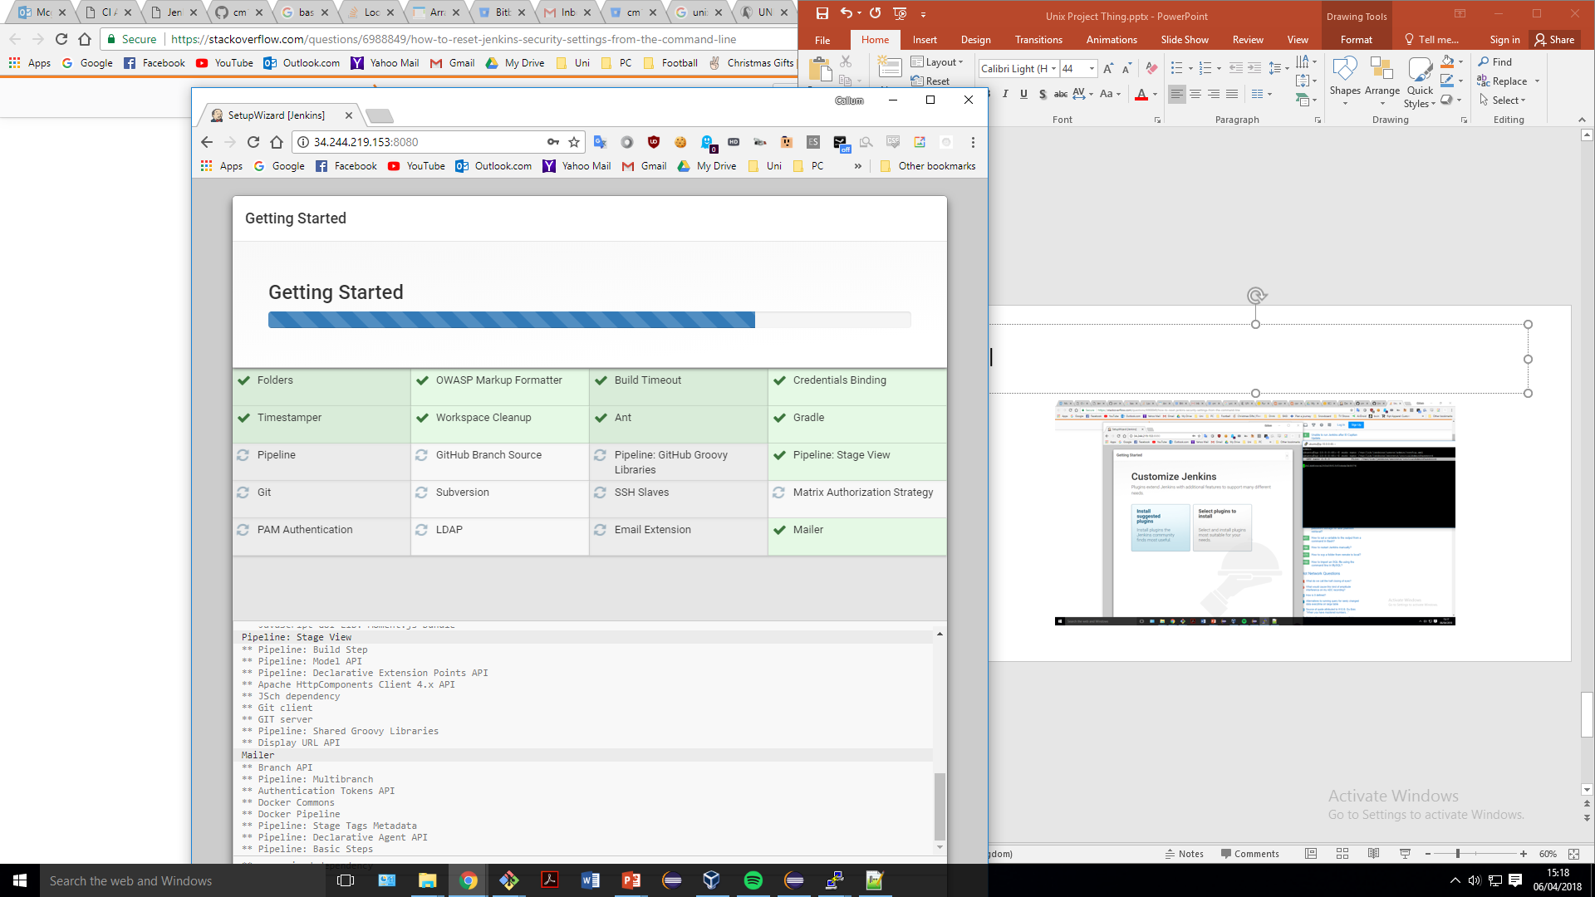
Installing all the plugins

Slide 15
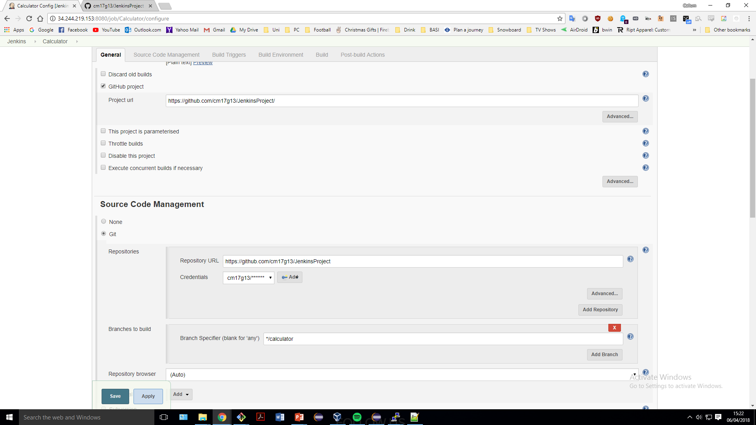
Creating the project

Slide 16
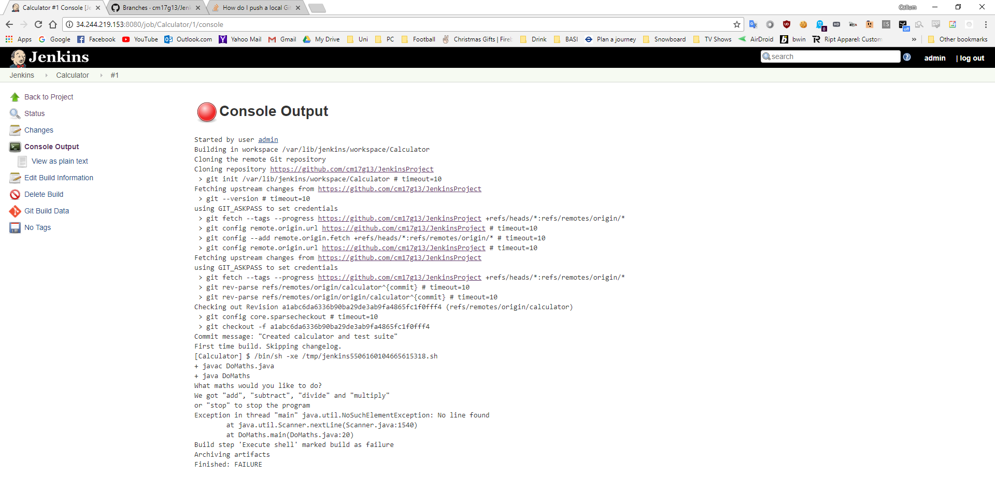
Jenkins project failing from no user input

